Slide 1
ARTA
Hololens
HDD System
Manual Control
World Camera
Camera Stream
YOLO
Navigation
World Manager
YACHT Tracker
Reactive Control
ARTA Alignment
Visuals
YACHT Direction

Slide 2
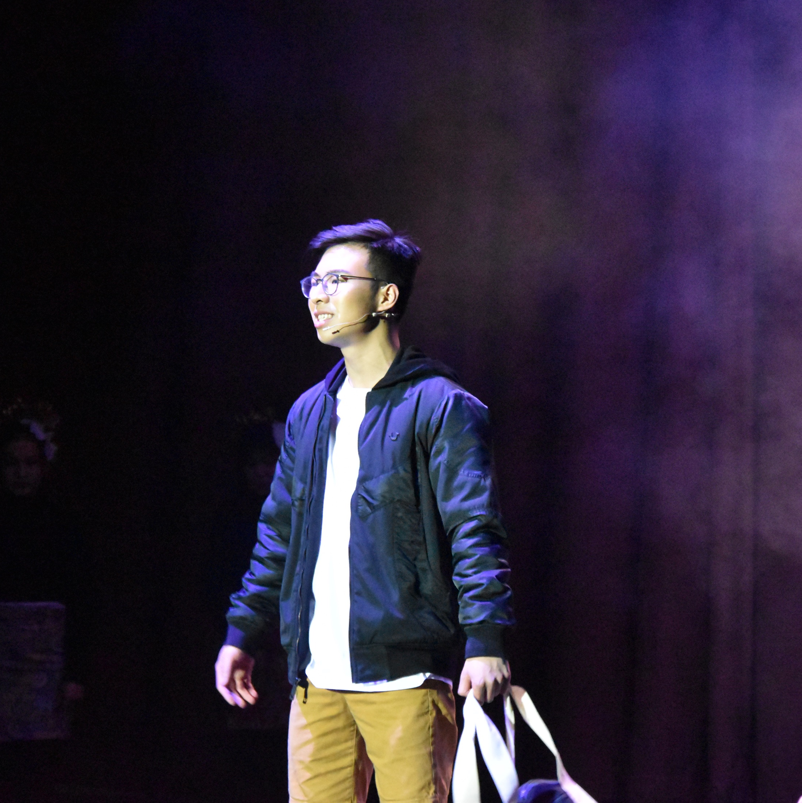
person

Slide 3
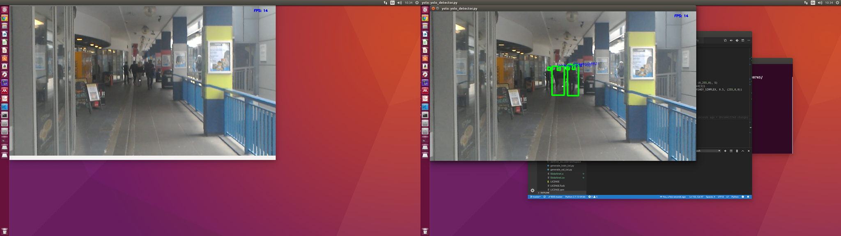
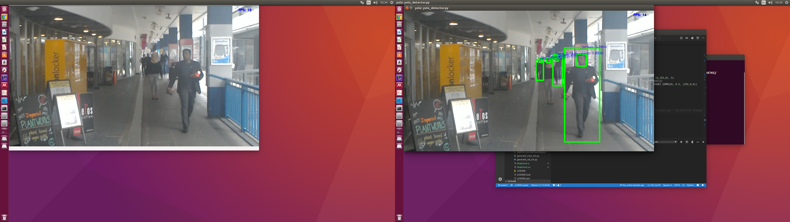
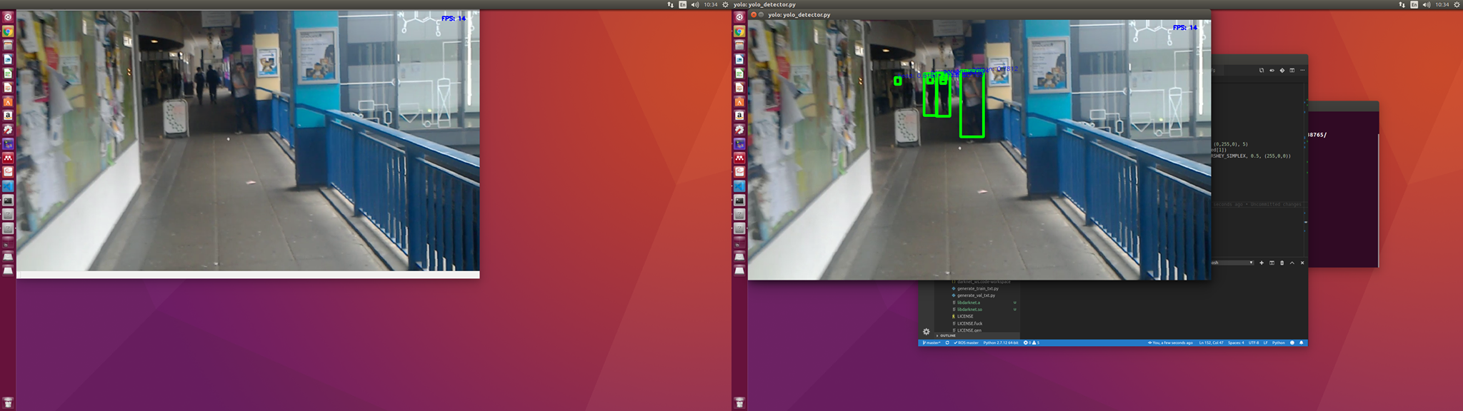

Slide 4
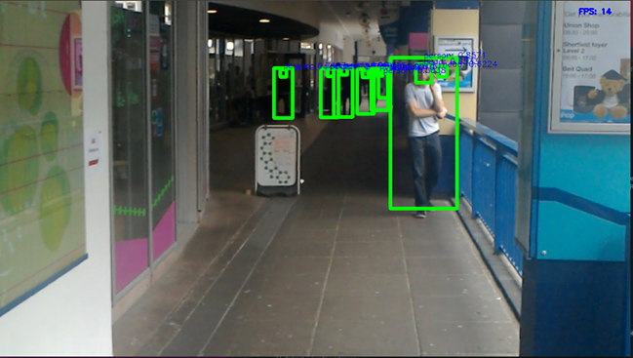

Slide 5
YOLO
YACHT
Bounding Boxes
Detector
DeepSort
Tracker
JPG Image
OpenPose
Confirmed Tracks
Unconfirmed Tracks
New Unconfirmed Tracks
Detections
NN Matching
IOU Matching
Matched Tracks

Slide 6
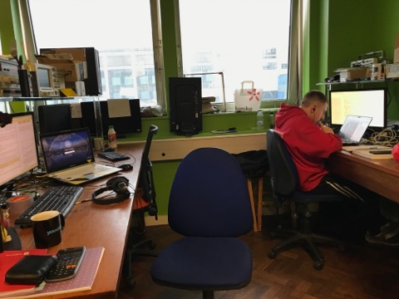
HDD System
1
YOLO
Bounding Box Detections
YACHT
JPG Image
DeepSort
Tracker
Detector
Tracking ID
OpenPose
Towards/Away

